Slide 1

Explain server technologies and management services associated with hosting and managing websites

Slide 2
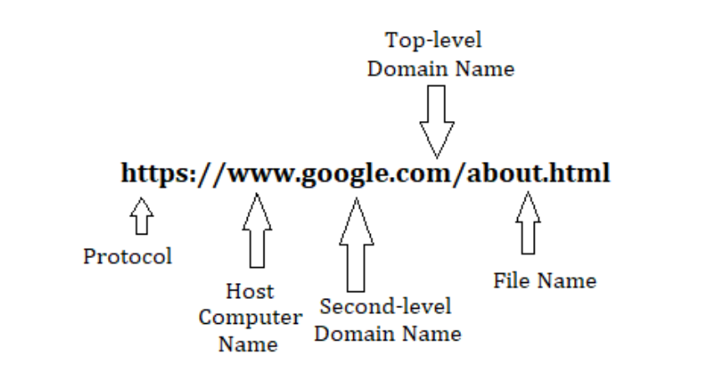
























URL: Universal Resource Locator
The user opens the browser and fills the address bar with a URL to open a website.
What is a URL?
the address of a resource on the Internet.
https://www.facebook.com/

Slide 3
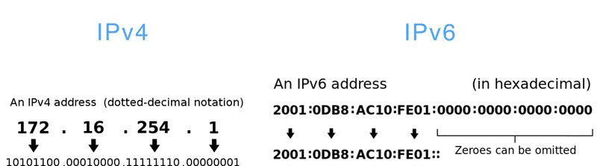





IP address
IP: Internet Protocol
Unique Number that is assigned to every device connected to the Internet.
Versions IPV4, IPV6 :
Notes:
Cmd ipconfig or ipconfig /all
Ping google.com -> ip address copy and paste in the address bar

Slide 4
Domain Name
The domain name is an address that we type in the browser search bar to visit a website. It is a unique name for a website. such as ‘google.com’, and ‘facebook.com’.

Slide 5
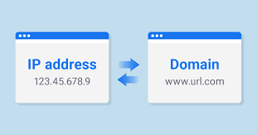
IP address vs. Domain Name

Slide 6










Domain Name Server
is basically a database or collection of all domain names with their corresponding IP numbers.

Slide 7
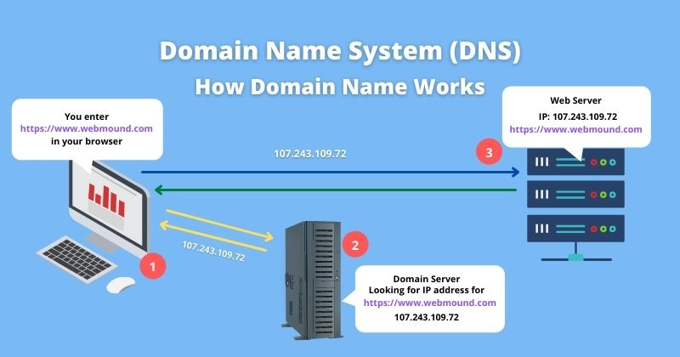















DNS Lookup

Slide 8
DNS Types
Recursive resolvers
01
Root
02
TLD (Top Level Domain)
03
Authoritative
04

Slide 9
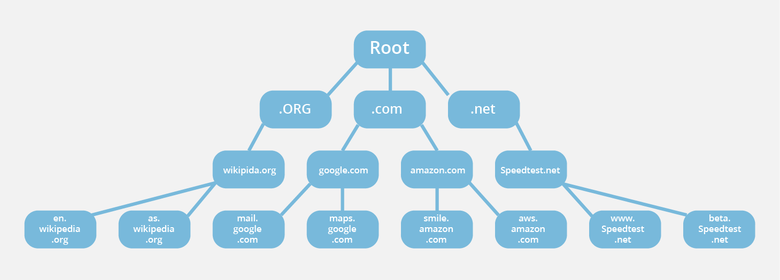










Notes:
https://www.cloudflare.com/en-gb/learning/dns/dns-server-types/
https://www.cloudflare.com/en-gb/learning/dns/what-is-dns/

Slide 10

Recursive resolvers
Is responsible for receiving queries from clients.
a recursive resolver will either respond with cached data, or send a request to a root nameserver, followed by another request to a TLD nameserver, and then one last request to an authoritative nameserver. After receiving a response from the authoritative nameserver containing the requested IP address, the recursive resolver then sends a response to the client.
Can be thought of as a librarian who is asked to go find a particular book somewhere in a library.
Notes:
Caching is the process of storing copies of files in a cache, or temporary storage location, so that they can be accessed more quickly.

Slide 11





Root
Is mainly the one responsible for translating the domain name to IP address.
A root server accepts a recursive resolver’s query which includes a domain name, and the root nameserver responds either directly for records stored or cached within the root zone or by directing the recursive resolver to a TLD nameserver, based on the extension of that domain (.com, .net, .org, etc.).

Slide 12
TLD
maintains information for all the domain names that share a common domain extension, such as .com, .net, or whatever comes after the last dot in a url.
For example, a .com TLD nameserver contains information for every website that ends in ‘.com’. If a user was searching for google.com, after receiving a response from a root nameserver, the recursive resolver would then send a query to a .com TLD nameserver, which would respond by pointing to the authoritative nameserver for that domain.

Slide 13
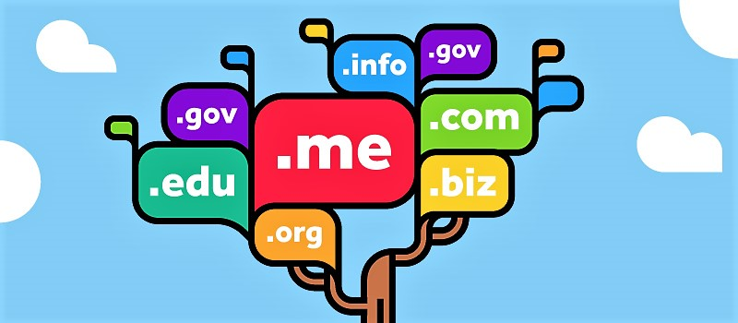

Slide 14
Countries’ TLD table
https://www.worldstandards.eu/other/tlds/

Slide 15
Authoritative
When a recursive resolver receives a response from a TLD nameserver, that response will direct the resolver to an authoritative nameserver. The authoritative nameserver is usually the resolver’s last step in the journey for an IP address. The authoritative nameserver contains information specific to the domain name it serves (e.g. google.com) and it can provide a recursive resolver with the IP address of that server found in.
this final nameserver can be thought of as a dictionary on a rack of books, in which a specific name can be translated into its definition.

Slide 16
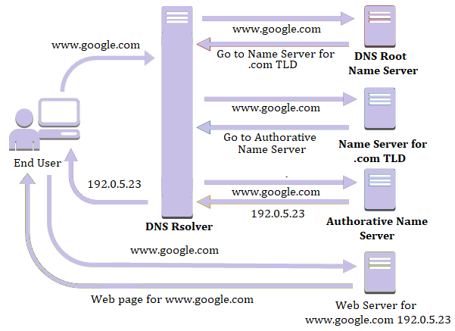





Notes:
https://www.cloudflare.com/en-gb/learning/dns/what-is-dns/
https://www.ques10.com/p/29009/what-is-url-explain-working-of-dns/

Slide 17

Explain the purpose and relationships between communication protocols, server hardware, operating systems and web server software with regards to designing, publishing and accessing a website
Notes:
https://www.cloudflare.com/en-gb/learning/dns/what-is-dns/
https://www.ques10.com/p/29009/what-is-url-explain-working-of-dns/

Slide 18






Communication Protocols
communication protocols are rules that determine the format and transmission of data. These protocols can be implemented via hardware devices, software or both.
Set of rules that govern data communication.

Slide 19
Communication Protocols:
HTTP
HTTPS
TCP/IP
FTP
SMTP
POP
UDP
DHCP

Slide 20



















HTTP
(Hyper Text Transmission Protocol) allows a client to start a connection with the server (HTTP request) and the server to acknowledge the request initiated by the client and responds accordingly (HTTP response).
HTTP response Status:
1xx Informational
2xx Success
3xx Redirection
4xx Client Error
5xx Server Error
‘200 OK’
‘404 NOT FOUND’
‘500 Internal Server Error’

Slide 21

HTTPs
Is the same as HTTP but transfers data in an encrypted format.
Notes:
SSL certificate

Slide 22
TCP/IP
(Transmission Control Protocol/Internet Protocol): used for data transmission, It prepares and forwards data packets across a network.
TCP divides any message into series of packets that are sent from source to destination.
IP is an addressing protocol. The IP addresses in packets help in routing them through different nodes in a network until it reaches the destination.

Slide 23
FTP
File Transfer Protocol to transfer computer files from a server to a client and vice versa

Slide 24
SMTP
Simple mail transport Protocol:
is an email protocol used for sending email messages from one email account to another via the internet.

Slide 25
POP
Post office Protocol (POP) for receiving incoming E-mails.

Slide 26
UDP
User Datagram Protocol A transport layer communication protocol, UDP is a very common protocol for voice and video traffic.

Slide 27
DHCP
Dynamic Host Configuration Protocol:
is a network management protocol used to dynamically assign an Internet Protocol (IP) address to any device.

Slide 28
Web Server
As a Hardware
Web server is a computer that stores web server software and a website's component files. (for example, HTML documents, images, CSS stylesheets, and JavaScript files) A web server connects to the Internet and supports physical data interchange with other devices connected to the web.
As a software
Web server includes several parts that control how web users access hosted files.

Slide 29
What does Webserver do?
Accepts the request from a web browser
Finds the requested document
Sends the document back to the browser through HTTP/HTTPS
If the server doesn't find the requested document, it returns a 404response instead
Notes:
https://developer.mozilla.org/en-US/docs/Learn/Common_questions/What_is_a_web_server

Slide 30




Webservers
Apache web server – the HTTP web server
Apache Tomcat
Microsoft’s Internet Information Services (IIS) Windows Server
Nginx web server

Slide 31
Xampp
XAMPP is a cross-platform service, as it works with platforms like Mac, Linux, Windows, etc.

Slide 32
Wampp
WampServer is a Windows web development environment. It allows you to create web applications with Apache2, PHP and a MySQL database

Slide 33

Notes:
https://www.youtube.com/watch?v=V9K1l3OL-Iw

Slide 34

capabilities and relationships between front-end and back-end website technologies and explain how these relate to presentation and application layers.

Slide 35
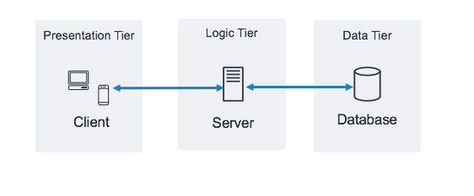
Three Tier model
Notes:
https://www.ibm.com/cloud/learn/three-tier-architecture

Slide 36
Presentation Layer
The presentation layer is the user interface and communication layer of the application.
where the end user interacts with the application, the user might fill his information
Run on web browser through graphical user interface (GUI), for example.
are usually developed using HTML, CSS and JavaScript.

Slide 37
Application Layer
The application layer, also known as the logic tier or middle tier, is the heart of the application.
In this tier, information collected in the presentation tier is processed - sometimes against other information in the data tier - using business logic, a specific set of business rules.
The application tier can also add, delete or modify data in the data tier.
The application tier is typically developed using Python, Java, Perl, PHP or Ruby, and communicates with the data tier using API calls.

Slide 38
Data Layer
The data layer, sometimes called database tier, data access tier or back-end.
Where the information processed by the application is stored and managed.
This can be a relational database management system such as PostgreSQL, MySQL, MariaDB, Oracle, DB2, Informix or Microsoft SQL Server, or in a NoSQL Database server such as Cassandra, CouchDB or MongoDB.

Slide 39
Front-End
The part that is displayed to the user (User Interface)
What he can see and interact with in the User Interface
Code that is executed at the browser and what client can see (Client-side) HTML, CSS and JavaScript
How the application looks like?

Slide 40
Back-End
Code that is executed at the web server (Server-side) using Java/ PHP/ C#.. Etc
How the application functions?

Slide 41
relationships between front-end and back-end
In order to develop a web application, you should take the front-end and back-end into consideration.
Front-end developers: are responsible for programming the presentation layer. They are experts in web technologies like Javascript, HTML5, and Cascading Style Sheets (CSS),
Back-end developers: program the business layer and data layer of an application. The internal logic of a web application
Web application development is a collaborative effort between front-end and back-end developers, although some organizations employ full-stack developers that can fit into either role.

Slide 42
relationships between front-end and back-end and How they relate to presentation and application layer
The Presentation Layer is the front-end layer of the application. Its main component is a graphical user interface (GUI) that allows users to interact with the application, accessing its functions and services.
The Application (Business/logic) Layer contains the application and business logic that facilitate the functions and services that the application provides. The logic for all application services is contained within the business layer, which sits between the presentation layer and the data layer.
The Data Layer is a back-end system that houses any data required for the application to deliver services and functionality to users.
Notes:
https://www.ibm.com/cloud/learn/three-tier-architecture
https://www.sumologic.com/glossary/web-application-development/

